Slide 1
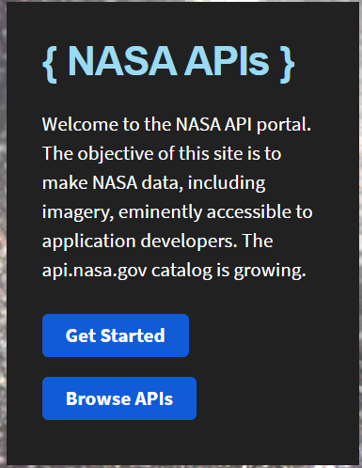
Meteor Screen
Step 1: Generate API key
Goto NASA Open APIs website.

Slide 2
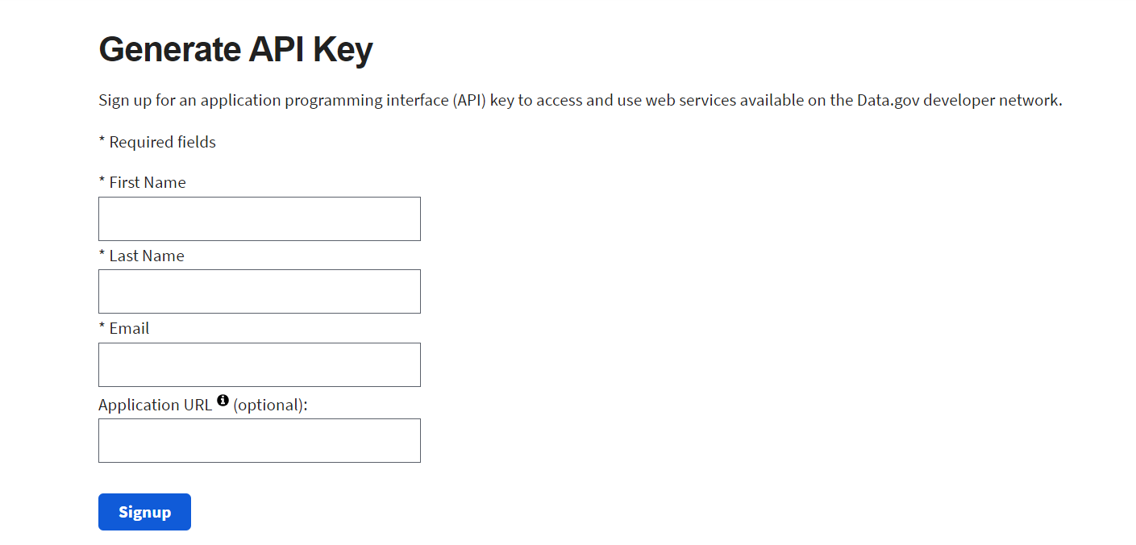
Steps to Generate API Key

Slide 3
Your API key for xyz@gmail.com is:
mt120vYgUwOeoqzoZG0wlCjucKhr50MhGCa94VVt
https://api.nasa.gov/planetary/apod?api_key=mt120vYgUwOeoqzoZG0wlCjucKhr50MhGCa94VVt
Demo Link : https://api.nasa.gov/neo/rest/v1/feed?api_key=DEMO_KEY

Slide 4
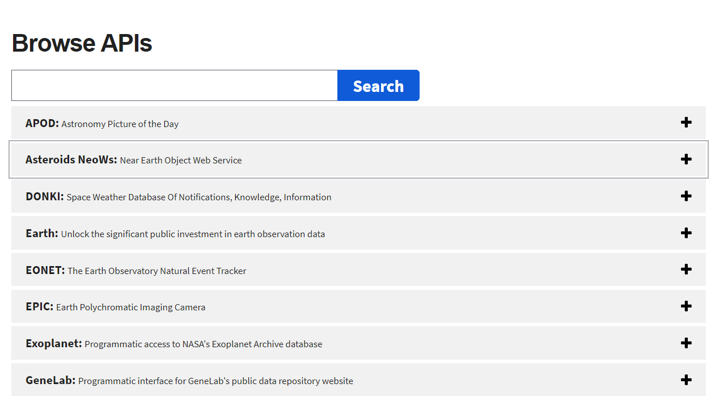

Slide 5
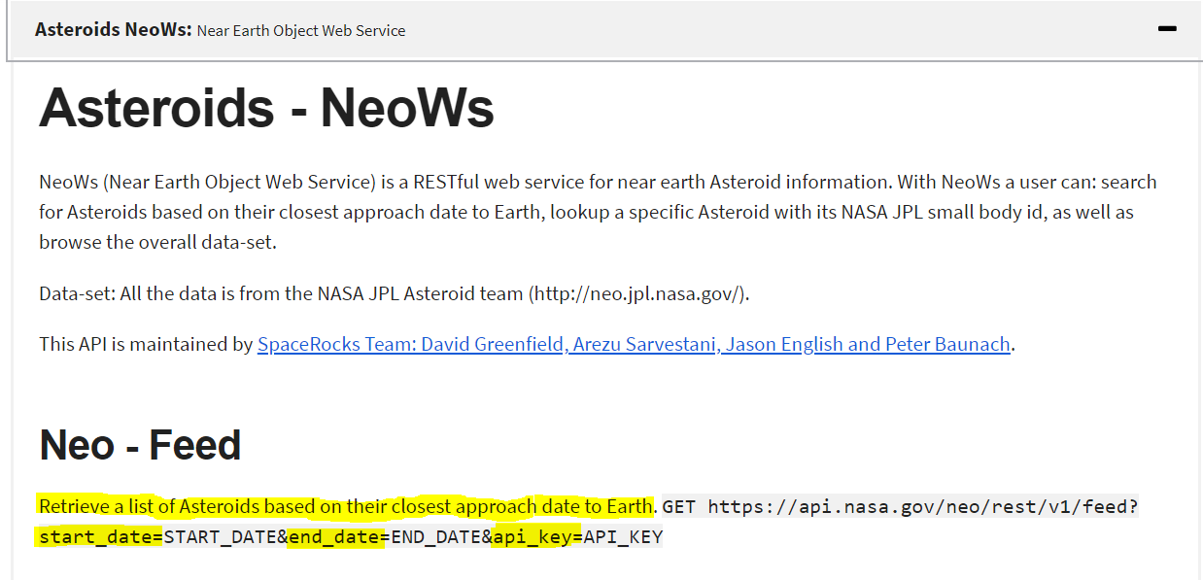

Slide 6
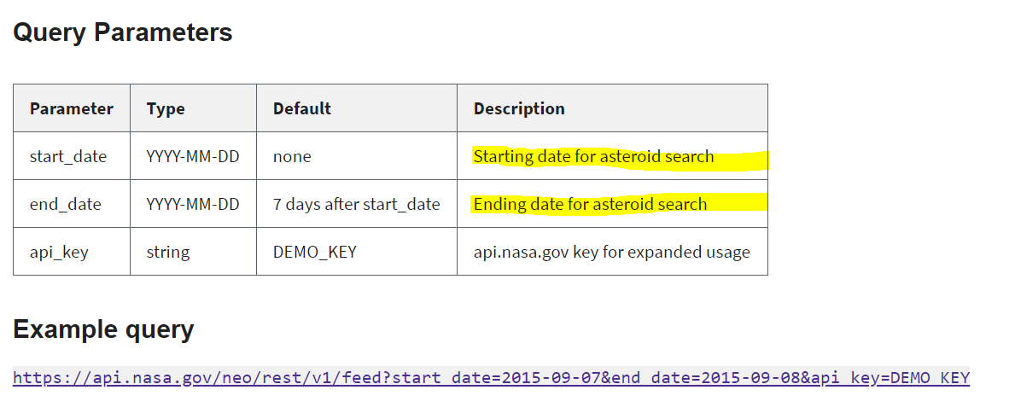

Slide 7
Let’s see the code

